Slide 1
Introduction to GeoXO ACX Science Team
Gregory Frost
NOAA Office of Oceanic and Atmospheric Research

Slide 2
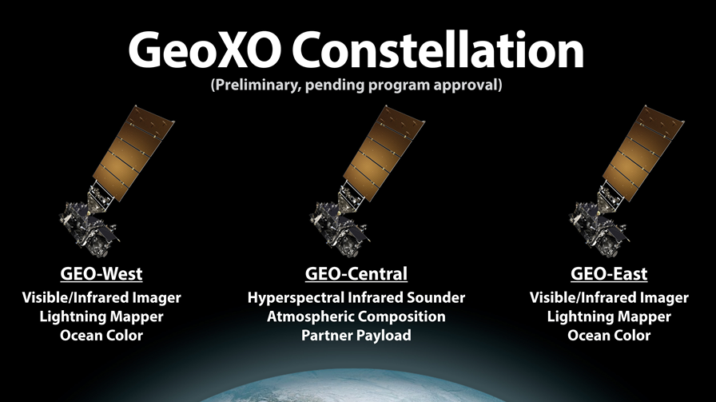
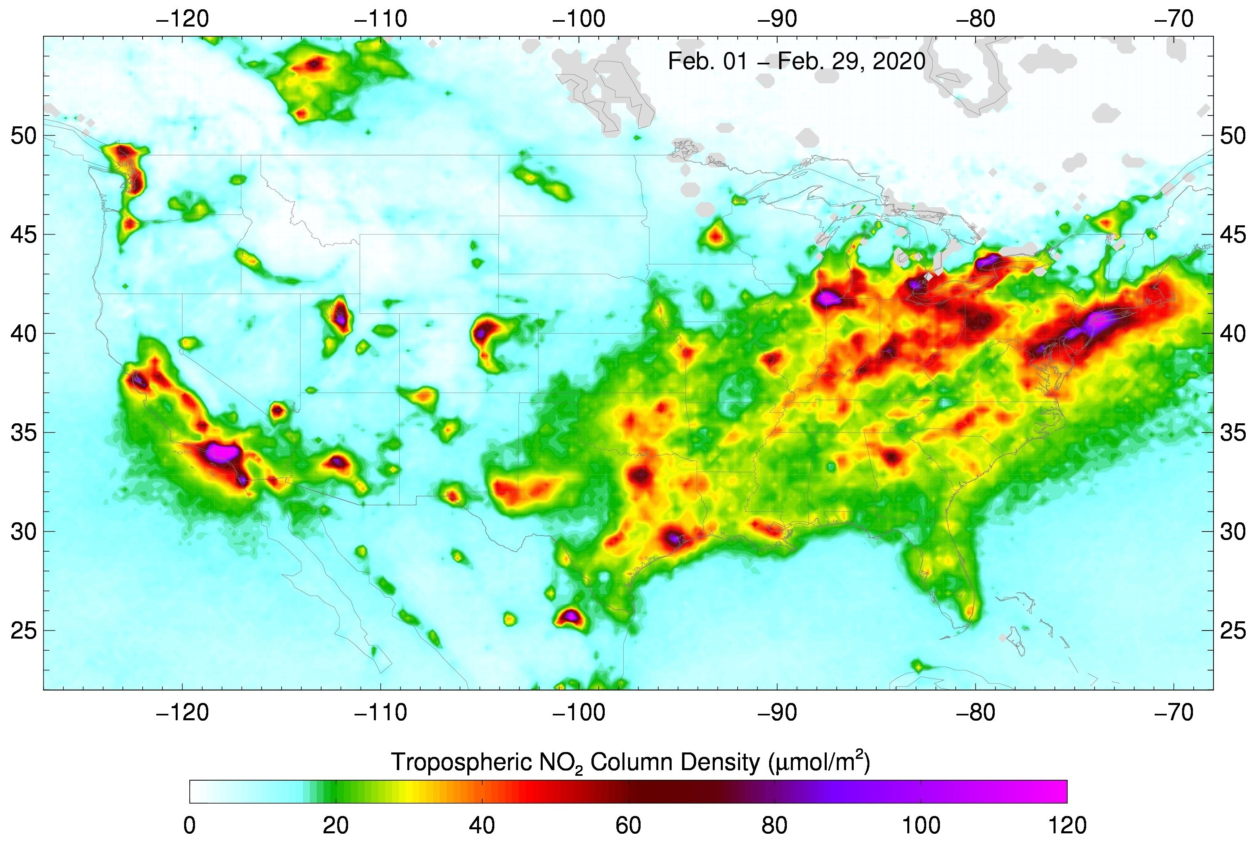
Responsibilities of the ACX Science Team
Provide scientific expertise on instrument design and product development, evaluations, and applications
Cultivate ACX user community
Collaborate on ACX relevant research via topical working groups
Meet periodically to discuss progress of ACX working groups and GeoXO activities
Provide reporting to NOAA and GeoXO Program as requested
Ozone
Nitrogen dioxide
Sulfur dioxide
Formaldehyde
Aerosol layer height
UV aerosol index
UV aerosol optical depth
UV-VIS SPECTROMETER ACX

Slide 3

Joanna Joiner
Affiliation: NASA Goddard Space Flight Center
Title: Atmospheric Physicist
Research interests:
Remote sensing and assimilation of atmospheric and surface parameters from satellite microwave, infrared, visible, and ultraviolet passive radiometers, including radiative transfer modeling, retrieval algorithm development, and data analysis
Areas of interest include tropospheric trace gases, clouds, chlorophyll fluorescence and other biospectral indicators, radiative and constituent fluxes
Relevant expertise:
EOS Aura Deputy Project Scientist 2005-2021
US OMI science team leader 2010-present
Co-Leader of NASA’s Ozone and Trace Gases team
Member of OMI, TEMPO, OMPS, GEMS, ABoVE, and PACE science teams
ACX Instrument Scientist

Slide 4
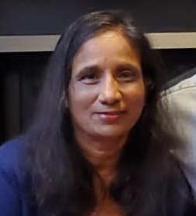
Shobha Kondragunta
Affiliation: NOAA National Environmental Satellite, Data, & Information Service
Title: Research Physical Scientist
Research interests:
Biomass burning emissions and their impact on air quality
Satellite air quality data applications
Education and outreach about NOAA air quality related satellite products
Policy relevant scientific studies
Relevant expertise:
Development of unique data analysis techniques
Development of aerosol and trace gas algorithms from LEO and GEO satellites
Lead, Aerosols and Atmospheric Composition Science Team
Lead, CEOS Atmospheric Composition Virtual Constellation aerosol subgroup
Manager, BIL project on fire contributions to air quality, climate, and linkages
ACX Product Scientist

Slide 5
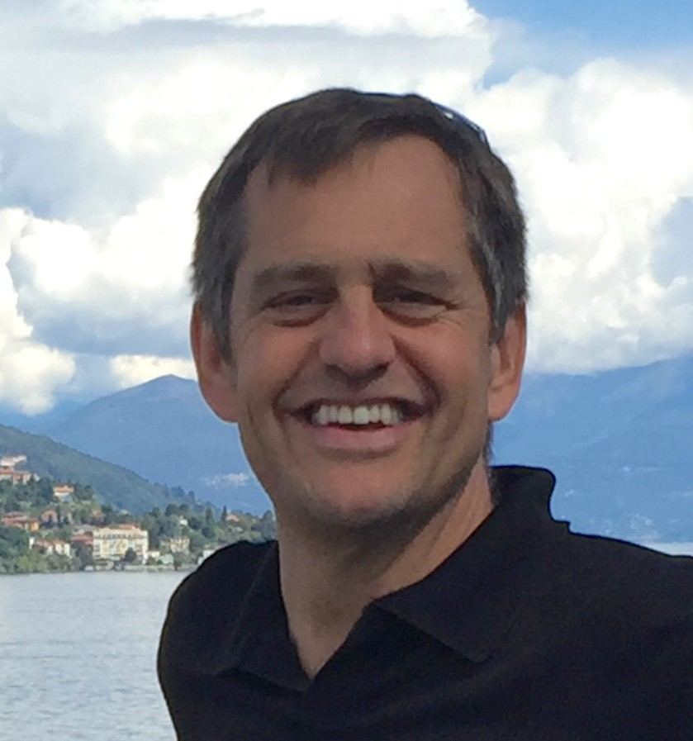
Greg Frost
Affiliation: NOAA Office of Oceanic and Atmospheric Research
Title: Supervisory Research Chemist
Research interests:
Emissions quantification and assessment
Air quality modeling and analysis
Satellite AC product evaluation and applications
Climate change mitigation
Relevant expertise:
Member, NASA GEO-CAPE Science Team
Member, GeoXO User Requirements Working Group
Co-Lead, Unified Forecast System Research to Operations Atmospheric Composition Team
Manager, NOAA Earth Radiation Budget Initiative
ACX User Scientist

Slide 6

Susan Anenberg
Affiliation: George Washington University, Milken Institute School of Public Health
Titles: Associate Professor, Environmental and Occupational Health; Director, GW Climate and Health Institute
Research interests:
Global environmental health
Urban air pollution and climate change
Environmental justice
Relevant expertise:
Assessing health impacts of NO₂, PM_{2.5}, ozone
Estimating urban air pollution levels
Characterizing air pollution injustice

Slide 7
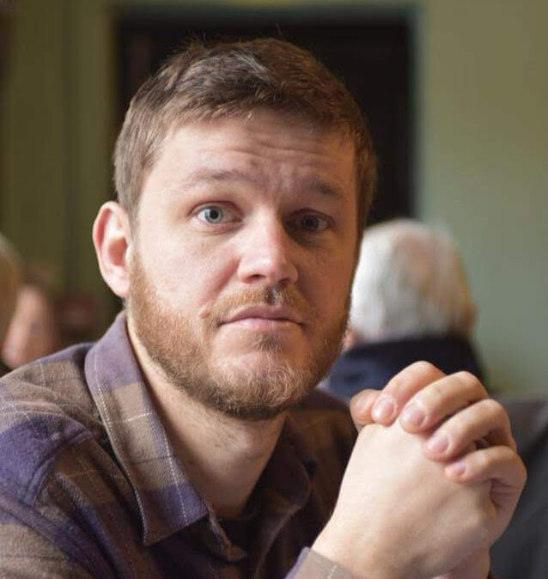
Jerome Barre
Affiliation: UCAR Joint Center for Satellite Data Assimilation (JCSDA)
Title: Atmospheric Composition Team Lead
Research interests:
Data assimilation
Air quality
Emissions inversions
Greenhouse gases
Research to Operations
Operations to Research
Relevant expertise:
10+ years in research for various satellite AC data assimilation systems
Technical implementations and maintenance expertise of operational systems
Expertise in coordination and management of large operational activities
Leading research to operations at JCSDA for atmospheric composition

Slide 8

Trevor Beck
Affiliation: NOAA National Environmental Satellite, Data, & Information Service
Title: Research Scientist
Research interests:
UV spectrometers
UV trace gas retrievals
Relevant expertise:
UV spectrometer calibration, algorithm, and data reprocessing

Slide 9

Patricia Castellanos
Affiliation: NASA Goddard Space Flight Center
Title: Research Meteorologist
Research interests:
Atmospheric remote sensing
Earth system modeling
Air quality
Relevant expertise:
Simulators of multi-angle polarimeters, lidars, and hyperspectral imagers for observing system simulation experiments (OSSEs) of aerosol and ocean color properties

Slide 10
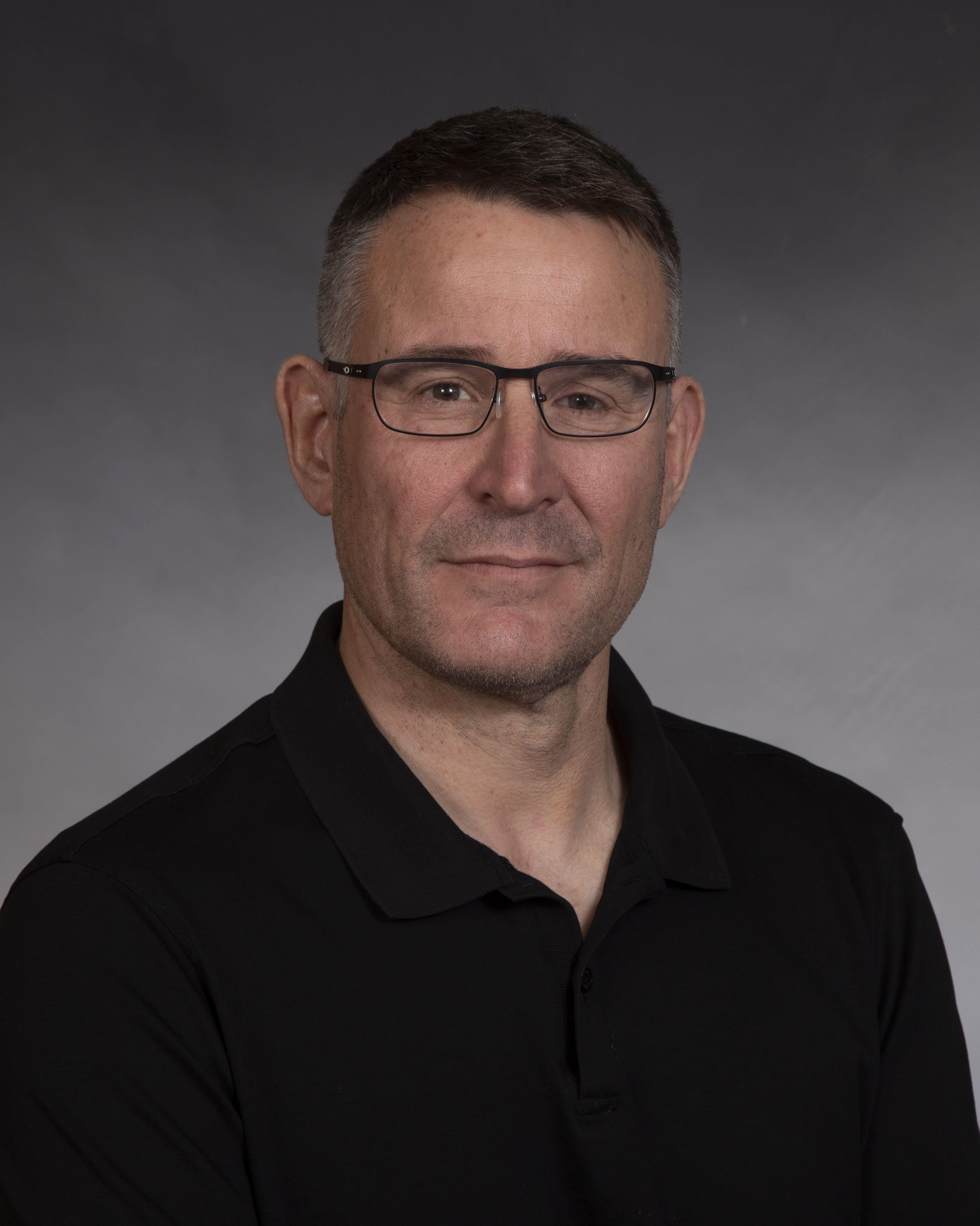
David Edwards
Affiliation: National Center for Atmospheric Research
Title: Senior Scientist
Research interests:
Using tropospheric remote sensing data to investigate trace gases and aerosols
Integrating cross-scale AC measurements from different observational platforms using chemical transport models and data assimilation
Designing new satellite AC approaches using OSSEs
Investigating diurnal variability of trace gas using GEO
Relevant expertise:
30 years in satellite AC remote sensing in every stage of mission development
Co-led NASA Terra/MOPITT mission
Science Team member on many international AC satellite missions, working groups and committees
Co-chair, Science Working Group, NASA Decadal Survey GEO-CAPE project
Science Team and Validation Team member for Korean GEMS mission
NASA Co-I for EVI-1 TEMPO mission

Slide 11

Larry Flynn
Affiliation: NOAA National Environmental Satellite, Data, & Information Service
Title: Research Scientist
Research interests:
Calibration and validation of satellite measurements and products for atmospheric composition applications
Relevant expertise:
In-orbit calibration and characterization of UV/Visible spectrometers
Implementation, evaluation and validation of ozone products
Research and development of trace gas retrieval algorithms

Slide 12
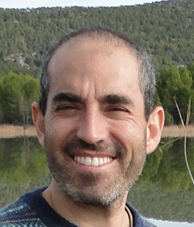
Gonzalo Gonzalez Abad
Affiliation: Center for Astrophysics, Harvard & Smithsonian
Title: Physicist (research scientist)
Research interests:
Characterization of AC, with focus on air quality and pollution
Environmental and social implications of degraded air quality
Remote sensing instrumentation, radiative transfer, chemical transport modelling, spectroscopy, and retrieval theory applied to AC observations
Validation of satellite AC measurements
Relevant expertise:
Member, TEMPO Science Team
Development of operational TEMPO trace gas retrievals (NO₂ and HCHO)
Development and maintenance of long-term data records of HCHO, glyoxal and water vapor retrievals from multiple satellite UV/Vis instruments
Development, maintenance and improvement of HCHO, glyoxal, bromine monoxide, chlorine dioxide and water vapor OMI retrievals

Slide 13
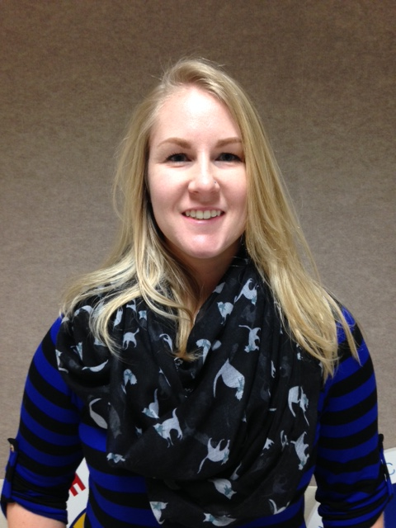
Kat Hawley
Affiliation: NOAA GeoXO Program
Title: GeoXO Lead Scientist for User Engagement
Research interests:
Understanding how information generates value in society
Creating an optimal customer experience
Strategies for extrapolating information for decision-making
Relevant expertise:
Serves as a strategic and tactical sounding board for the GeoXO leadership and broader management team on all aspects of user engagement:
Best practices
Engagement activities
Outreach
User training
Documentation
User readiness
User sustainment

Slide 14
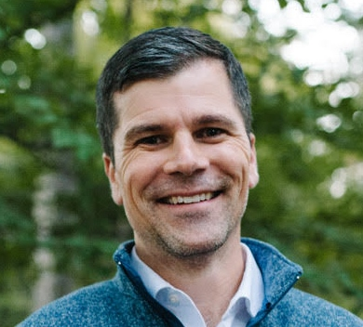
Barron Henderson
Affiliation: U.S. EPA Office of Air Quality Planning and Standards
Title: Physical Scientist
Research interests:
Global- to regional-scale chemical transport modeling
Background sources of ozone
Satellite-based evaluation of trace gases and aerosols
Assimilation of satellite observations
Constraining emissions and chemical kinetics based on observations
Relevant expertise:
Application of OMI and TropOMI NO₂ data assimilation
Working to bring GEO satellite observations into AirNow
Developed and contributed to tools for CMAQ satellite evaluation
Regular participation in NASA HAQAST, including Ambassador program
Contributor to TEMPO Early Adopters Program trainings
Contributing author to “Monitoring Surface PM_{2.5}: An International Constellation Approach to Enhancing the Role of Satellite Observations”

Slide 15
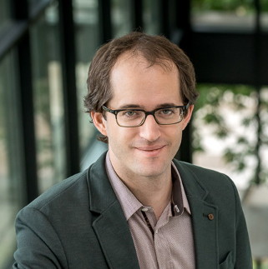
Daven Henze
Affiliations and Titles:
Professor, Mechanical Engineering, University of Colorado, Boulder
Adjunct Research Scientist, Lamont-Doherty Earth Observatory, Columbia Univ.
Research interests:
Data assimilation and inverse modeling
Aerosols and air quality
Climatology and atmospheric chemistry
Adjoint sensitivity analysis
Remote sensing
Energy systems optimization
Air pollution health impacts
Relevant expertise:
Assimilation of aerosol and trace gas retrievals for emissions estimation and forecasting
Satellite retrieval design
Inverse modeling and data assimilation methods

Slide 16

Laura Judd
Affiliation: NASA Langley Research Center
Titles: Research Physical Scientist, Associate Program Manager
Research interests:
Expanding the utility of high spatial and temporal measurements of ozone and ozone precursors
Better understanding the relationship between emissions and meteorology with respect to air quality
Improving the interpretation of column-based observations with other measurement and modeling perspectives
Relevant expertise:
High spatial and temporal resolution NO₂ and HCHO remote sensing retrievals
Validation of column-based observations from airborne and ground-based measurements
Planning and implementation of airborne air quality science field studies

Slide 17
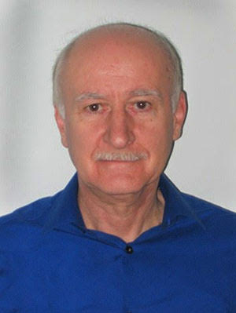
Istvan Laszlo
Affiliation: NOAA National Environmental Satellite, Data, & Information Service
Title: Research Physical Scientist
Research interests:
Remote sensing of aerosols and shortwave radiation budget from space-based observations
Modeling radiative transfer in the atmosphere
Relevant expertise:
Developed and implemented algorithms for retrieving shortwave, UV-A/B, erythemal and photosynthetically active radiation from Imagers on geostationary satellites
Directing development and evaluation of aerosol optical depth retrievals from the Advanced Baseline Imager (ABI) on board the GOES-R series of satellites and from the Visible Infrared Imaging Radiometer Suite (VIIRS) on board polar-orbiting satellites.

Slide 18

Xiong Liu
Affiliation: Center for Astrophysics, Harvard & Smithsonian
Title: Deputy PI for TEMPO
Research interests:
Remote sensing of atmospheric trace gases, aerosols, and clouds
Remote sensing data validation and analysis
Satellite instrument development and calibration
Radiative transfer modeling
Relevant expertise:
Development of TEMPO and MethaneSAT missions
Leads TEMPO & MethaneSAT retrieval algorithm development
Responsible for TEMPO L0-1b and ozone profile algorithm
Developed advanced ozone profile and tropospheric ozone retrieval algorithm from GOME and OMI
Contributed to UV/Vis trace gas retrievals and joint UV/IR ozone profile retrieval

Slide 19

Randall Martin
Affiliation: Department of Energy, Environmental & Chemical Engineering, Washington University in St Louis
Title: Raymond R. Tucker Distinguished Professor
Research interests:
Air quality
Satellite remote sensing of atmospheric composition
Chemical transport modeling
Globally distributed ground-based measurement network of fine particulate matter mass and composition
Relevant expertise:
Member of multiple science teams for satellite instruments: MAIA, TEMPO, MODIS-VIIRS Atmosphere, and GEMS
Model Scientist, GEOS-Chem chemical transport model
Leads a global fine particulate matter network (SPARTAN) to evaluate and enhance satellite-based estimates of fine particulate matter

Slide 20

Brian McDonald
Affiliation: NOAA Office of Oceanic and Atmospheric Research
Title: Environmental Engineer
Research interests:
Emissions of air pollutants and greenhouse gases from urban, energy, and transportation systems
Atmospheric modeling
Satellite data analysis
Relevant expertise:
Development of emission inventories of energy and urban systems
Assessments of air quality trends
Regional air quality modeling
Co-Chair, Global Emissions Initiative (GEIA)
Member of science teams for many NOAA field campaigns

Slide 21

Brad Pierce
Affiliation: University of Wisconsin-Madison
Titles: Director, Space Science and Engineering Center; Professor, Atmospheric and Oceanic Sciences Department
Research interests:
Global and regional air quality modeling
Satellite chemical and aerosol data assimilation
Relevant expertise:
PI, Real-time Air Quality Modeling System (RAQMS)
Member of NOAA NGGPS Aerosols and Composition Team: integrating RAQMS into Unified Forecast System and developing JPSS data assimilation capabilities
Member of TEMPO Science Team: developing global and regional data assimilation systems to utilize TEMPO measurements
Member of NOAA Systems performance Assessment Team (SAT): providing guidance to NOAA on requirements for future AC measurements

Slide 22

Ivanka Stajner
Affiliation: NOAA National Weather Service
Title: Deputy Director, NOAA/NWS/NCEP/Environmental Modeling Center
Research interests:
Air quality prediction
AC prediction
Inclusion of AC and air quality into coupled Earth system models
Data assimilation
Relevant expertise:
Coordination and prioritization of improvements for operational prediction of air quality and AC
Assimilation of satellite AC data

Slide 23

Jim Szykman
Affiliation: U.S. EPA Office of Research and Development
Title: Senior Research Engineer
Research interests:
Conducts applied research focused on the integration of multivariate datasets, focused on application of satellite aerosol and trace gas data, to help provide answers relevant to the US EPA national air quality program in the areas or source attribution, spatial pollutant distributions, and trends
Relevant expertise:
2 decades+ research experience in remote sensing and the use of satellite data for air quality applications.
Member of TROPOMI S5P Validation Team and TEMPO Science Team
Co-lead for validation of TEMPO L2 geophysical data products
EPA lead for development of the Unified Ceilometer Network, focused on use of ceilometers for continuous planetary boundary layer observations
Worked to extend Pandonia Global Network of Pandora spectrometers across TEMPO’s field of view for satellite trace gas validation

Slide 24
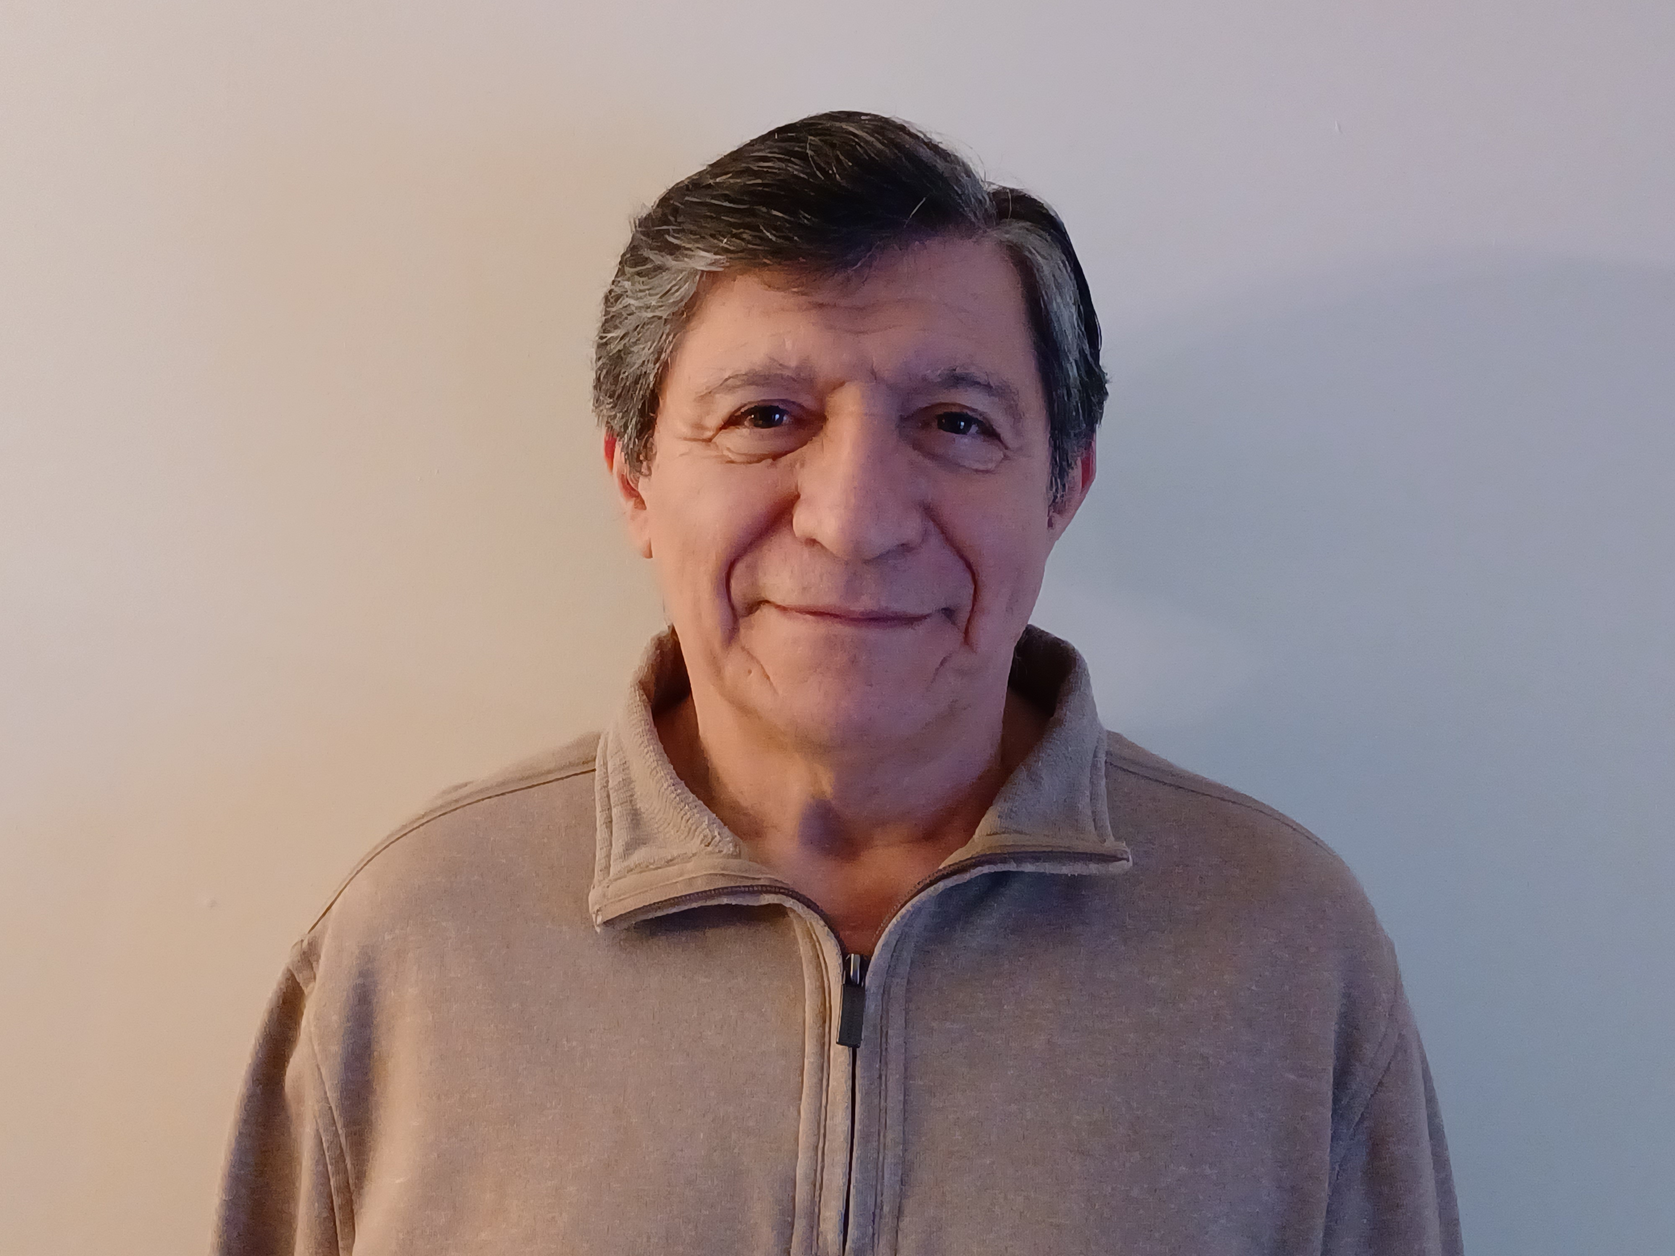
Omar Torres
Affiliation: NASA Goddard Space Flight Center
Title: Physical Scientist
Research interests:
Atmospheric aerosols characterization
Aerosol radiative effects
Space-based aerosol remote sensing
Relevant expertise:
Retrieval of aerosol properties using near-UV observations under cloud free conditions
Retrieval of properties of above-cloud aerosols
Aerosol effects in satellite measurements of ozone and other trace gases

Slide 25
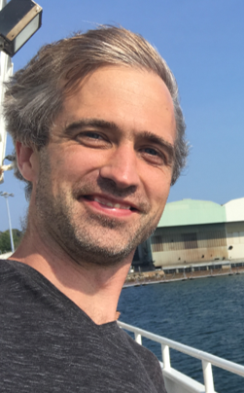
Luke Valin
Affiliation: US EPA Office of Research and Development
Title: Research Physical Scientist
Research interests:
Gas-phase photochemistry
Reactive air emissions quantification
Relevant expertise:
Satellite-based measurement validation and applications
Identification of air quality data gaps
Member of validation team for TEMPO L2 geophysical data products

Slide 26

Jun Wang‡
Affiliation: The University of Iowa
Title: James E. Ashton Professor
Research interests:
Satellite remote sensing of fires and atmospheric composition
Earth system modeling of atmospheric chemistry and climate change
Relevant expertise:
Radiative transfer, particle scattering, optimization and inverse modeling
Satellite remote sensing theory, information content analysis
End-to-end development of algorithms for retrieving aerosol properties from multi-wavelength, multi-angle, hyperspectral, and/or polarimetric measurements
Developed the algorithm for combined use of O2 B and A bands to retrieve aerosol layer height, at each daytime hour from EPIC/DSCOVR and once per day from TROPOMI
Atmospheric chemistry modeling
‡Starting in May 2024

Slide 27
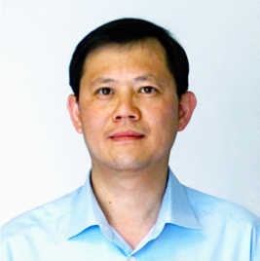
Kai Yang
Affiliation: University of Maryland College Park
Title: Research Scientist
Research interests:
Atmospheric trace gases (NO₂, SO₂, and O₃)
Air pollution
Volcanic emissions
Relevant expertise:
Remote sensing measurements
Retrieval algorithm development
Product validation
Instrument characterization and calibration
Atmospheric radiative transfer modeling

Slide 28
ACX Science Team
Susan Anenberg
Jerome Barre
Trevor Beck
Patricia Castellanos
David Edwards
Lawrence Flynn
Gregory Frost*³
Gonzalo Gonzalez Abad
Katherine Hawley
Barron Henderson
Daven Henze
Joanna Joiner*¹
Laura Judd
Shobha Kondragunta*²
Istvan Laszlo
Xiong Liu
Randall Martin
Brian McDonald
R. Bradley Pierce
Ivanka Stajner
Jim Szykman
Omar Torres
Luke Valin
Jun Wang‡
Kai Yang
Ozone
Nitrogen dioxide
Sulfur dioxide
Formaldehyde
Aerosol layer height
UV aerosol index
UV aerosol optical depth
Advisors:
Andrew Heidinger
Dan Lindsey
Mitch Goldberg
Walter Wolf
Monika Kopacz
Kathryn Mozer
Barry Lefer
Support:
Victoria Breeze
Shiv Das
*Science Team Co-Leads
UV-VIS SPECTROMETER
ACX
¹ACX Instrument Scientist
²ACX Product Scientist
³ACX User Scientist
‡Starting May 2024

